Slide 1
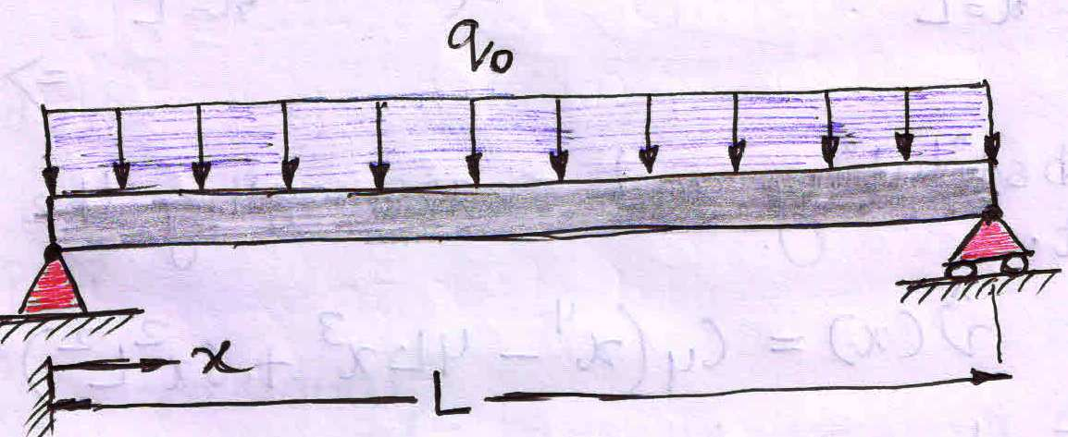
EXAMPLE 1: Consider the problem of a simply supported beam under uniformly distributed load q₀ as shown in the figure. The governing differential equation is given by:
the boundary conditions :
Solution through one-term trial solution:
Step-1: (Assume the Trial Solution satisfying the boundary conditions)
As the Governing D.E is of order four, trial or guess solution for the above differential equation can be an algebraic trial solution of order four.
However, we may make the process simple by choosing trigonometric trial functions.
As per our requirement this single parameter trial solution satisfies all the boundary conditions.
Step-2: (To find the Domain Residual)
Substituting the Trial solution into the governing differential equation will lead domain residual indicating the amount of error in the assumed Trial solution.
[As is not the exact solution of the D.E]

Slide 2
Step-3: (To minimize the Domain Residual)
The Domain Residual indicates the error through out the domain (Ω) of the given differential equation. So in order to approximate the Trial Solution with the Exact Solution, the Domain Residual is tried to be minimized.
(Which is a function of “x”)
As magnitude of the domain residual depends on the value of C₁ which is again a function of “x’ so domain residual will be varying from point to point within the domain (0< x < L).
So in this case we can not ensure the domain residual to become zero through out the domain, rather we will try to make it zero at some selected points.
The number of points in the domain about which the domain residual is to be made zero, are to be decided based on the number of unknown constants we have in the Trial Solution.
In the present Trial solution we have only one unknown constant (C₁) ; hence in order to decide this constant we have to make the R_{d} zero at any one point in the domain selectively.
This point can be any random point in the domain.

Slide 3
This technique is called the Point Collocation Technique where in the residual (In general a function of “x’) is set to zero at chosen points within the domain. The number of points being equal to the number of coefficients in the trial function that needed to be determined.
Let us make the domain residual to be zero at some specific locations within the domain and check the accuracy of the Trial Solution with respect to the Exact Solution.
(i) R_{d} = 0 at x = L/4:
So for making R_{d} = 0 at x = L/4
(ii) R_{d} = 0 at x = L/2:
So for making R_{d} = 0 at x = L/2
(iii) R_{d} = 0 at x = L/3
So for making R_{d} = 0 at x = L/3

Slide 4
Let us now compare the deformation results (v (x)) obtained by the different Trial Solutions obtained by making the domain residual to vanish at specific points within the domain (x = L/4, L/2, L/3), with respect to the Exact Solution.
Exact Solution
Trial Solution by making R_{d} = 0 at x = L/2
Trial Solution by making R_{d} = 0 at x = L/3
Trial Solution by making R_{d} = 0 at x = L/4
Let us compare the results for a specific case where:
The uniformly distributed load = q₀ = 1000 N/mm
Young’s Modulus of Elasticity = E = 200,000 MPa
Moment of Inertia of the beam CS = I = 4 x 10⁶ mm⁴
Length of the beam = L = 1000 mm

Slide 5
Deflection (v)
Normalized axis location on the beam (x/L)
It may be noted that each of the Trial solution deviates appreciably from the exact solution.
In a similar manner the Residual results obtained for different Trail Solutions may also be compared with respect to each other.

Slide 6
For Trial Solution obtained by making R_{d} = 0 at x = L/2
For Trial Solution obtained by making R_{d} = 0 at x = L/3
For Trial Solution obtained by making R_{d} = 0 at x = L/4
Residual (R_{d})
Normalized axis location on the beam (x/L)

